Slide 1
Project Check In
Sylvia Jerden

Slide 2
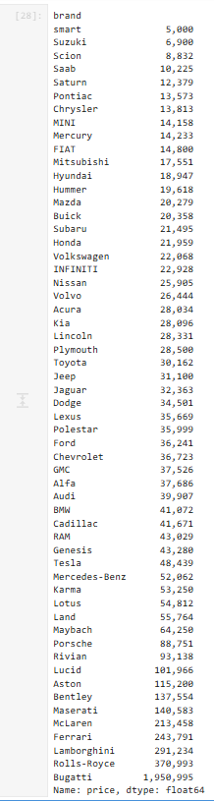
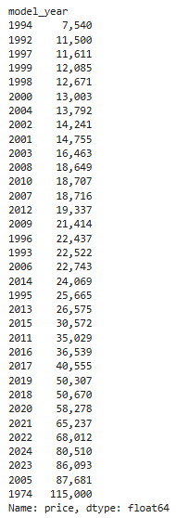
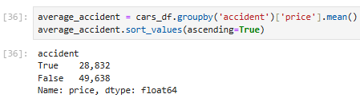
Initial Analysis
Car price averages based on brand, year, and if the car has been in an accident

Slide 3
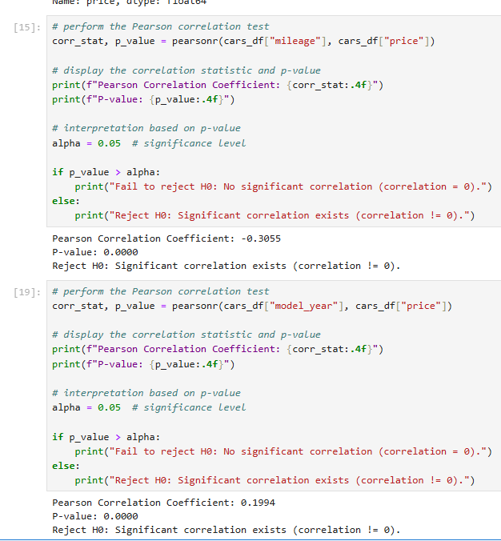
Initial Analysis
A Pearson correlation test was run to test the relationship between mileage and year with price
Mileage has a negative correlation coefficient with price, and has a significant correlation
Model Year has a positive correlation coefficent with price, and has a significant correlation

Slide 4
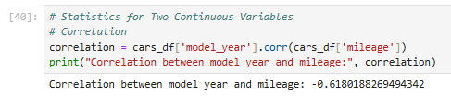
Initial Analysis
Correlation between the year of a car and the mileage of the car is negative

Slide 5
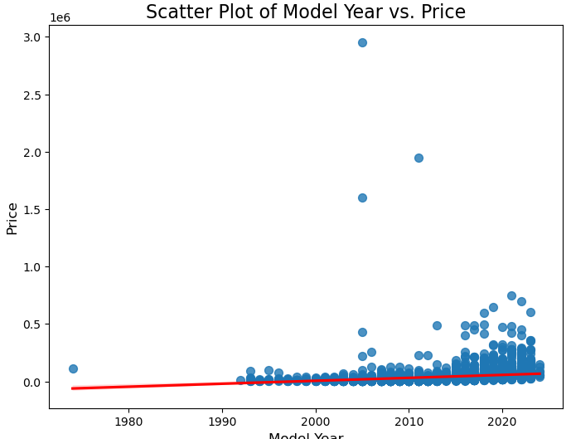
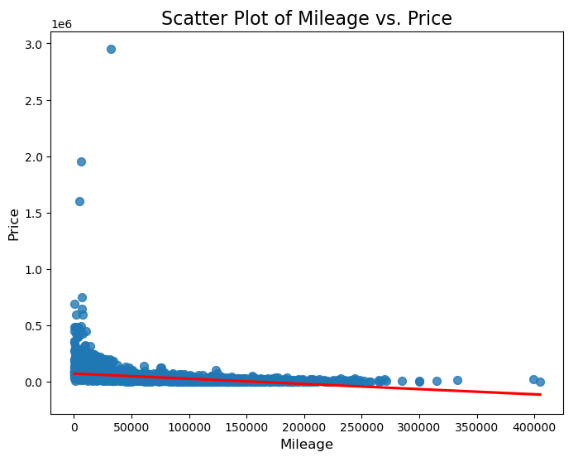

Slide 6
Roadmap/Next Steps
Figure out what's causing selenium to not scrape certain variables, and then scrape an adequate amount of data from the site
Definitively decide on all analysis that needs to be done
I think that a linear regression to determine car price could be an interesting analysis with this dataset
Clean the datasets by removing rows that are unnecessary for analysis and possibly remove entries with null data depending on how much is missing.
Perform all analysis and generate visualizations
Create final report for project including all analysis, visualizations, and explanations

Slide 7
Questions
When I scrape cars.com, it will take my first three variables (name, mileage, and price) and only scrape some of them at complete random. Is there a way I can scrape all these consistently?
This is the main thing holding me back from other things in my project, as these are some of the most important things I am looking at. I cannot scrape the data I need if selenium skips these, especially since if these are missing, they don't leave a blank they skip the entry entirely. Because of this, if anything is missing, I cannot create my DataFrame in the first place.

